Slide 1

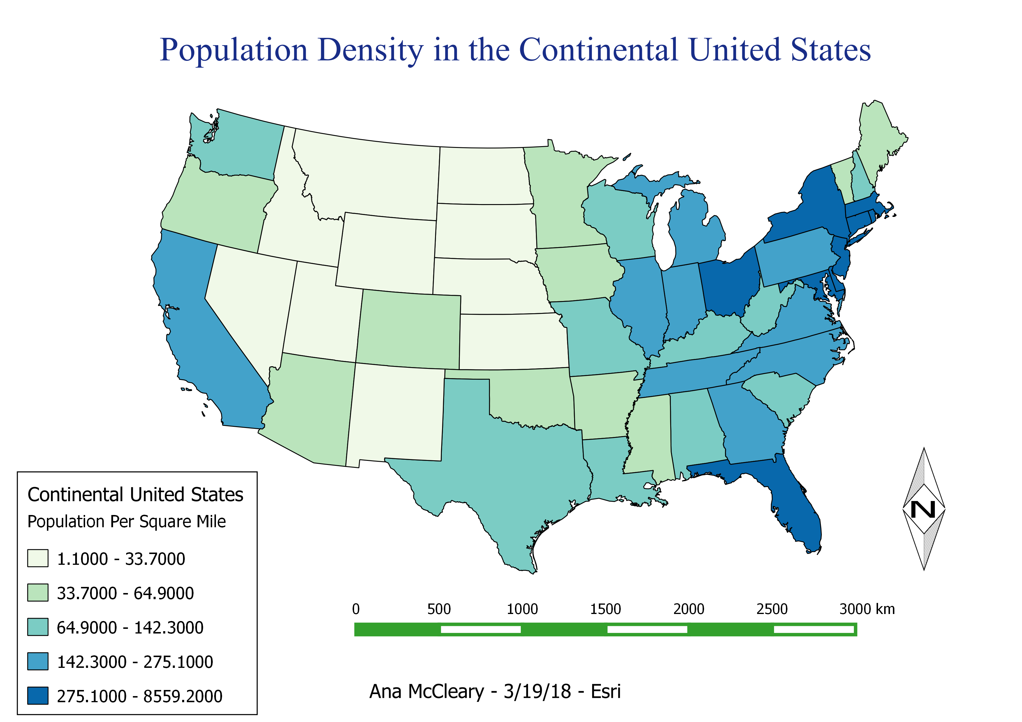
GIS Data Finder
Coder: Ana McCleary
Be able to more efficiently find the data you’re looking for to pop into ArcMap!
Too much data to sift through in your geodatabase? This program is designed to cut down time clipping data in your shapefiles.

